Slide 1
MOVIES DATA ANALYSIS
Created By: GREEN ANACONDA TEAM
Team Members: Austin Kegarise, Craig Topham,
Temi Jegede, Ivan Vodovozov
Date: April 10th, 2018

Slide 2
Project Objectives
Green Anaconda Team:
identified historical data trends based on movie release counts by year
visualized relationships between various data metrics such as movie budget, revenue, vote and popularity of starring actors
evaluated movie datasets from 1916 - 2017 in order to provide end-users with important movie details related to user-specified actors.

Slide 3
Analytical Questions
It appears the number of movies released per year has increased historically. Can we support this hypothesis with data?
Do the amount of box office revenues represent the quality of movies, based on avg viewer votes?
What effect do the size of movies’ budgets have on box office revenues and avg viewer vote?
How do starring actors’ popularity impact box office revenues and avg viewer vote?
Certain actors have historically had great success right from their career onset. What does data result tell us about an actor’s career progression (using Harrison Ford)?

Slide 4
Analytical Questions
Do movie descriptions/plots generally have a positive, negative or neutral sentiments attributed to them (actor specific)?
For specific actors, is there a trend for target audience?

Slide 5
Data Resources
Kaggle’s tmdb_5000_movies.csv (https://www.kaggle.com/tmdb/tmdb-movie-metadata/data)
Kaggle’s tmdb_5000_credits.csv (https://www.kaggle.com/tmdb/tmdb-movie-metadata/data)
The Open Movie Database - OMDB API (http://www.omdbapi.com/)

Slide 6
Data Exploration & Clean-Up Process
Some fields in the csv files were “lists of data dictionaries”. Example: we separated genre data dictionary field column into individual columns by using .eval function and a for loop through each column to grab needed values.
Merged OMDB API with kaggle’s 5000_credit.csv and 5000_movies.csv to identify needed fields.
Removed irrelevant columns from dataframes
Renamed column headers appropriately
Sorted (in asc.) and re-indexed by “Year Released” column

Slide 7
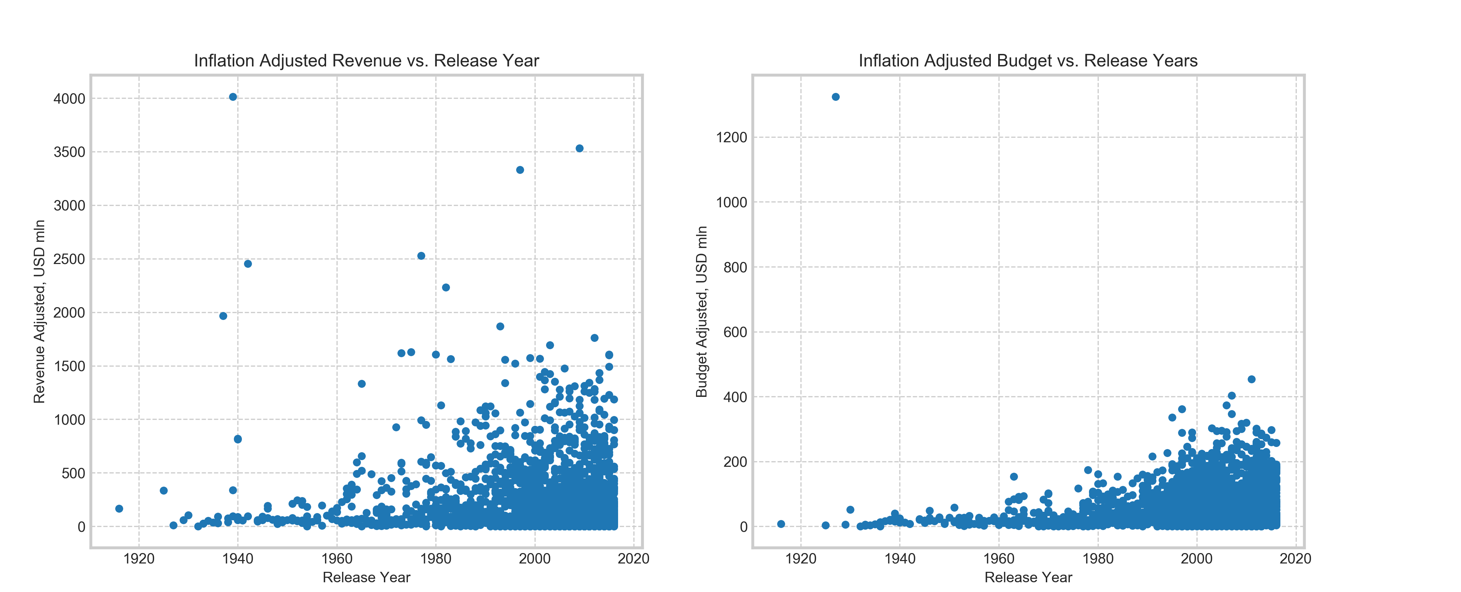
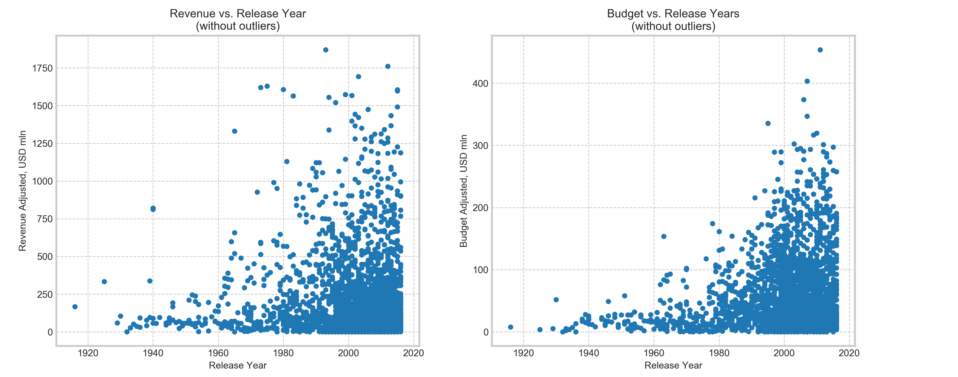
Data Exploration & Clean-Up Process
Money value outliers were identified and tagged for exclusion from scatter plots used in this analysis

Slide 8
Data Analysis Process
Read in the 2 csv files (tmdb_5000_movies.csv & tmdb_5000_credits.csv)
Starring actors popularity metric was generated for each movie, based on movies’ revenue and cast data
For each of 3 starring actors of each movie, weighted revenues of all their prior movies were totaled
The weighting decreases prior revenues at 2% for each year of the movie age, relative to the movie considered
Money values were converted to present day value
Because counts of movies released increased dramatically through years, release year buckets were created to enable analysis for different historic stages
Same for budgets – buckets were assigned
Using the Title on one of the csv files, call OMDB API to pull additional data fields

Slide 9
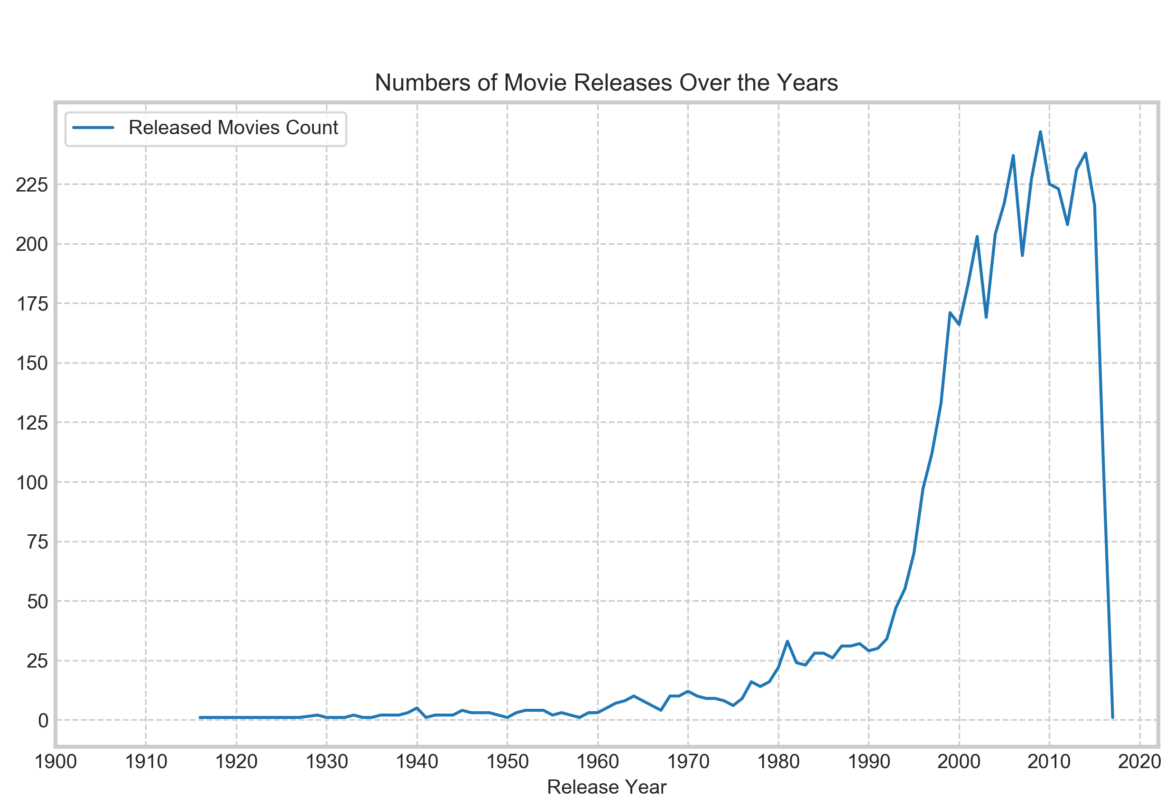
Visualizations
It appears the number of movies released per year has increased historically. Can we support this hypothesis with data?

Slide 10
Major Findings
Between 1910 – 1980, the number of movies released were low (generally below 25 counts). Year 1980 – 2017 saw the highest increase in movie releases, going from 25 to apprx. 250 counts, with the sharpest rise occurring between 1990 – 2000.

Slide 11
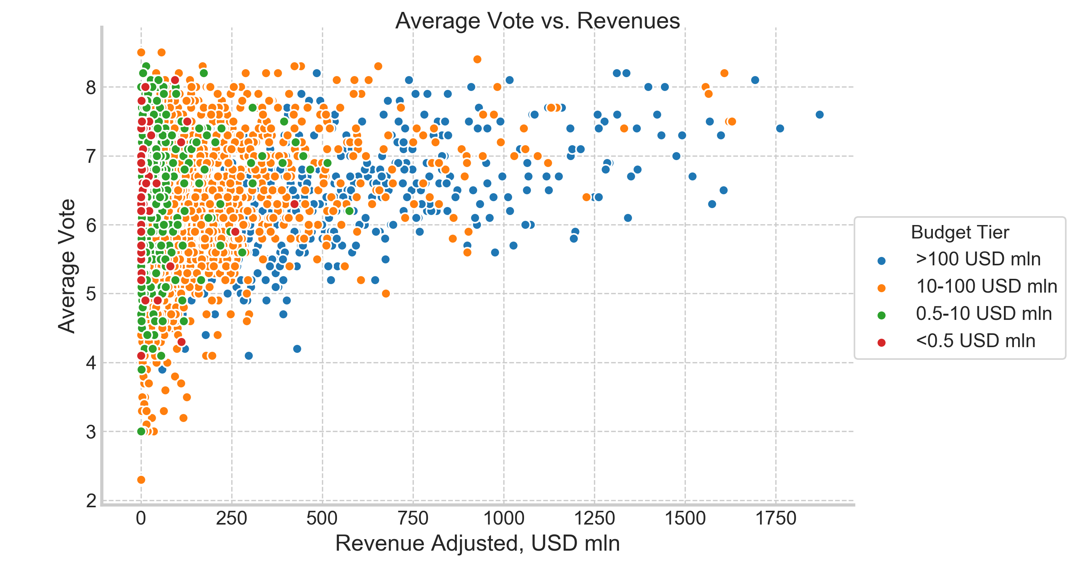
Visualizations
Do the amount of box office revenues represent the quality of movies, based on avg viewer votes?

Slide 12
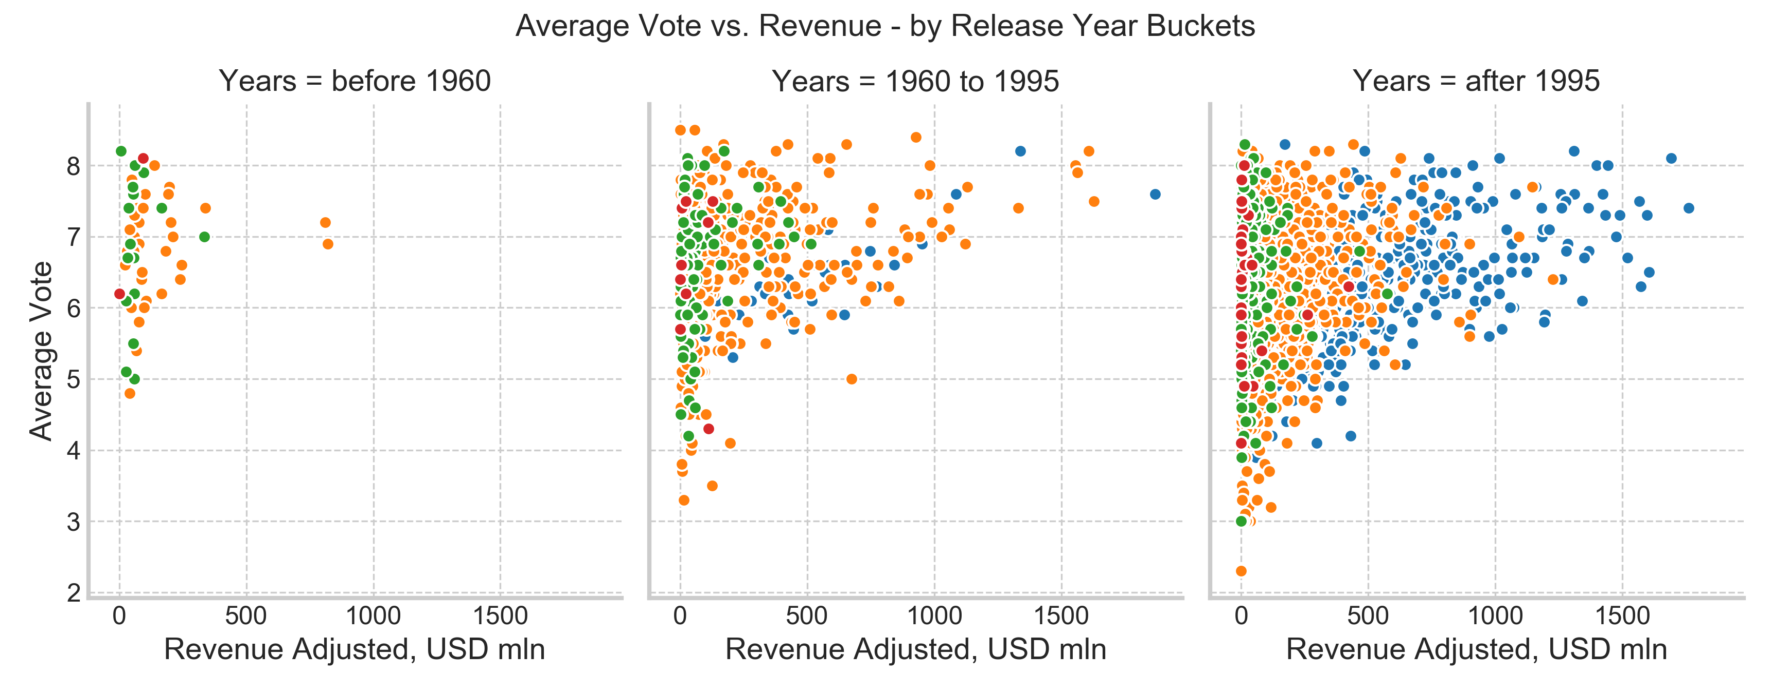
Major Findings
The higher the box office revenues, less likely the movie is estimated low
On the other hand, the vote does not necessarily increase with increase of movie revenues
Revenue does not indicate the quality of a movie. Movies with low revenues are estimated as high as do the movies with high revenues. This is so for recent movies and movies released in the past.

Slide 13
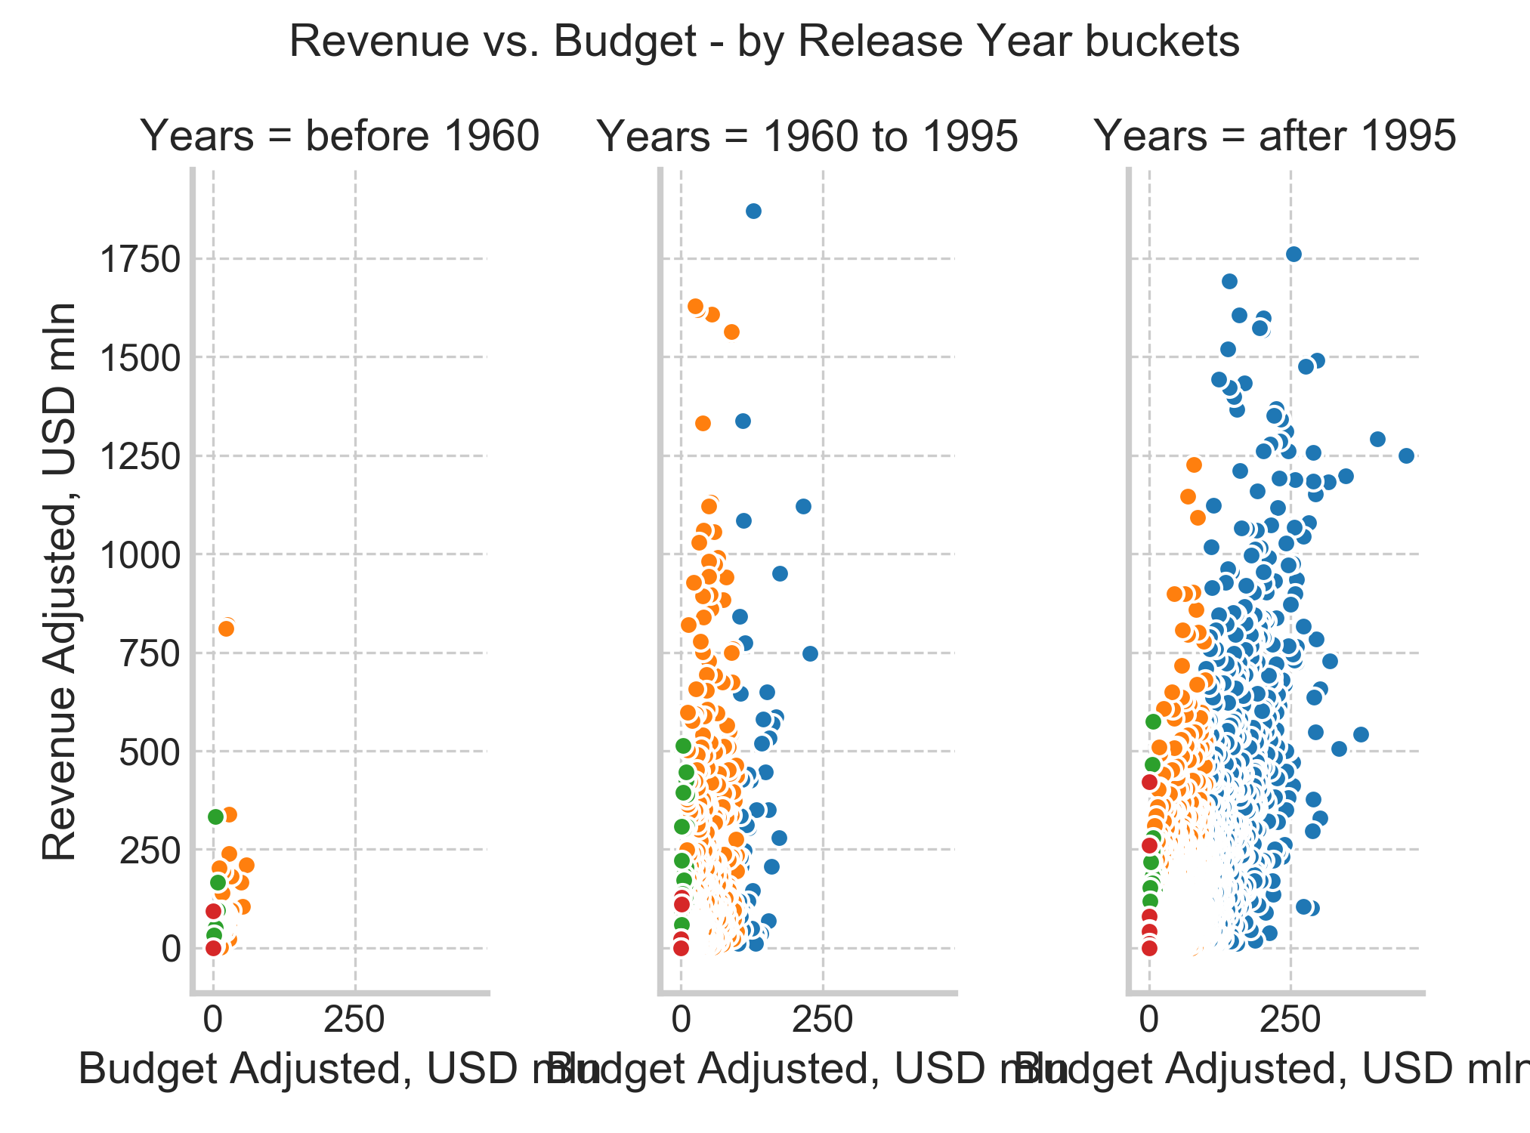
Visualizations
What effect does the amount of movies’ budget have on box office revenues and on avg viewer vote?

Slide 14
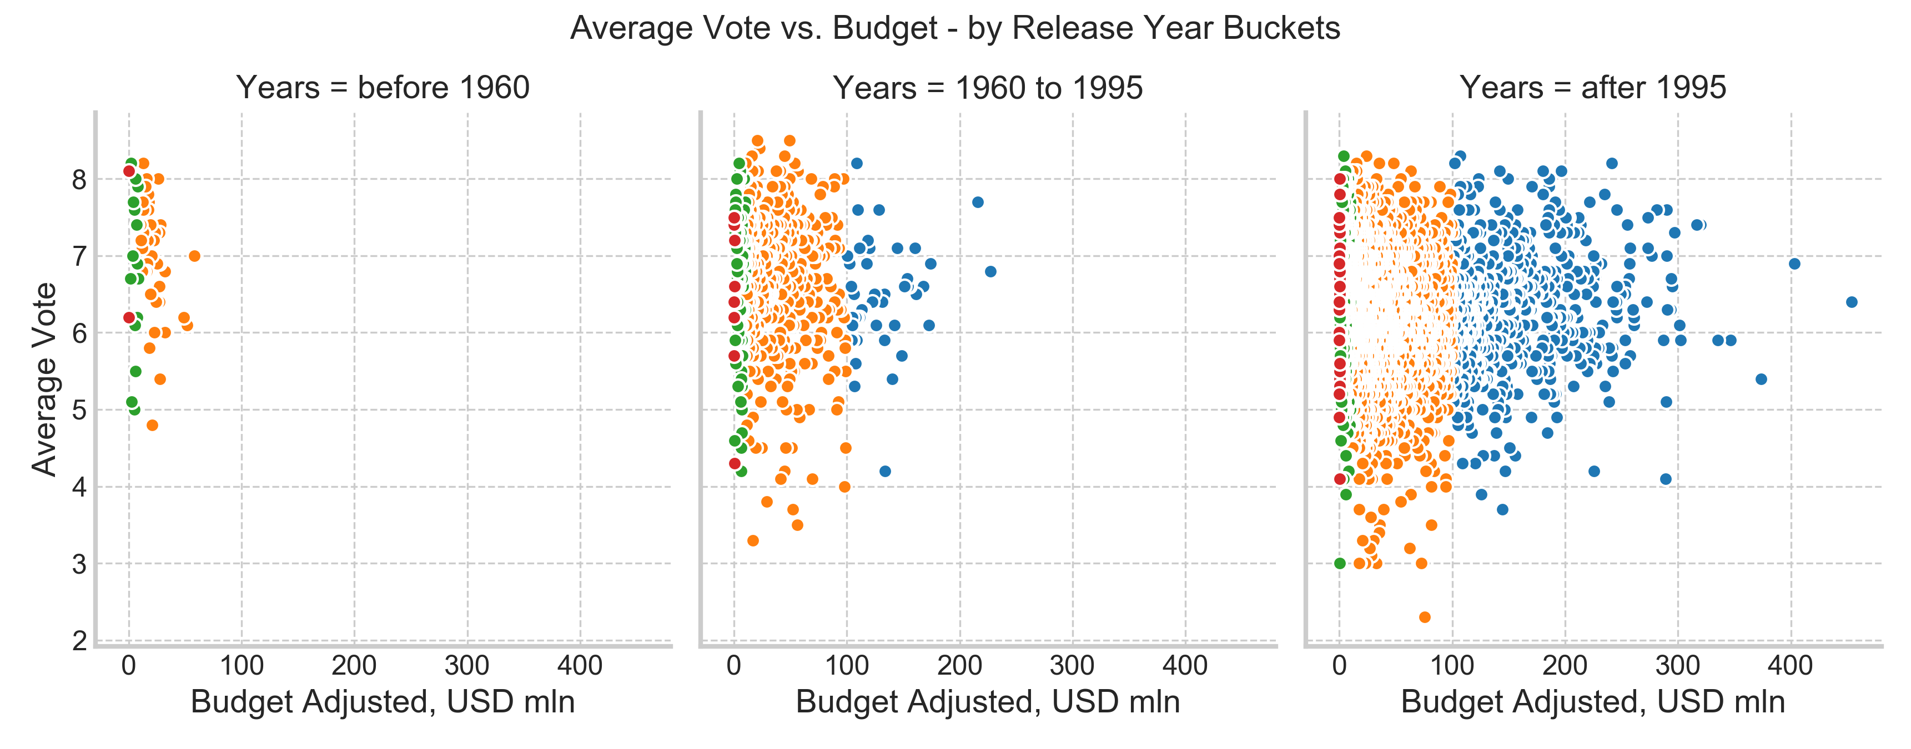
Visualizations
What effect does the amount of movies’ budget have on box office revenues and on avg viewer vote?

Slide 15
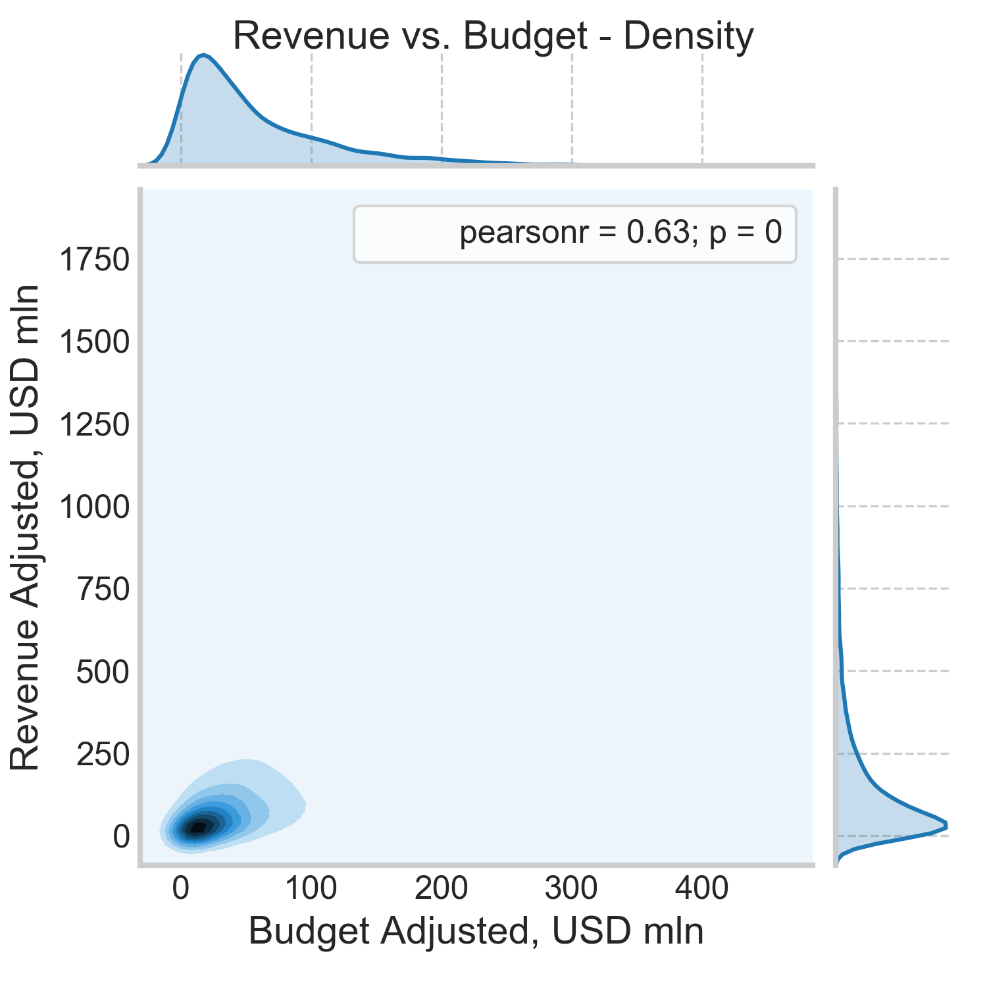
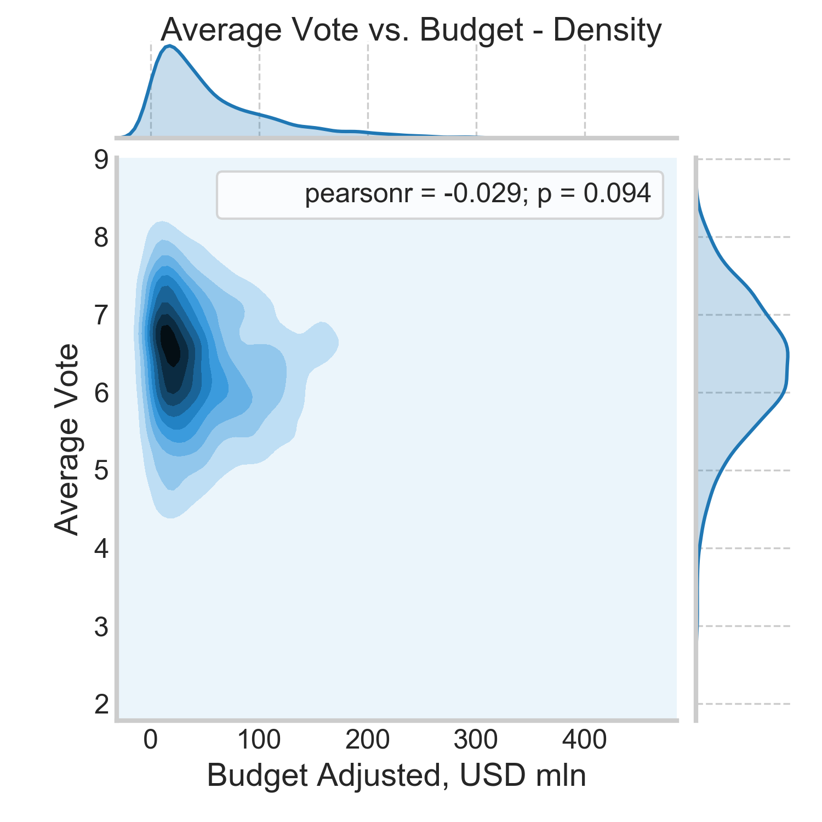
Major Findings
Film revenues do have considerable linear dependency on budgets, although the variance is high and thus budgets are not the only determining factor
Higher movies budget tends to narrow the vote range. Movies with lower budgets have votes varying significantly. This is observed especially for more recent movies (previous slide)

Slide 16
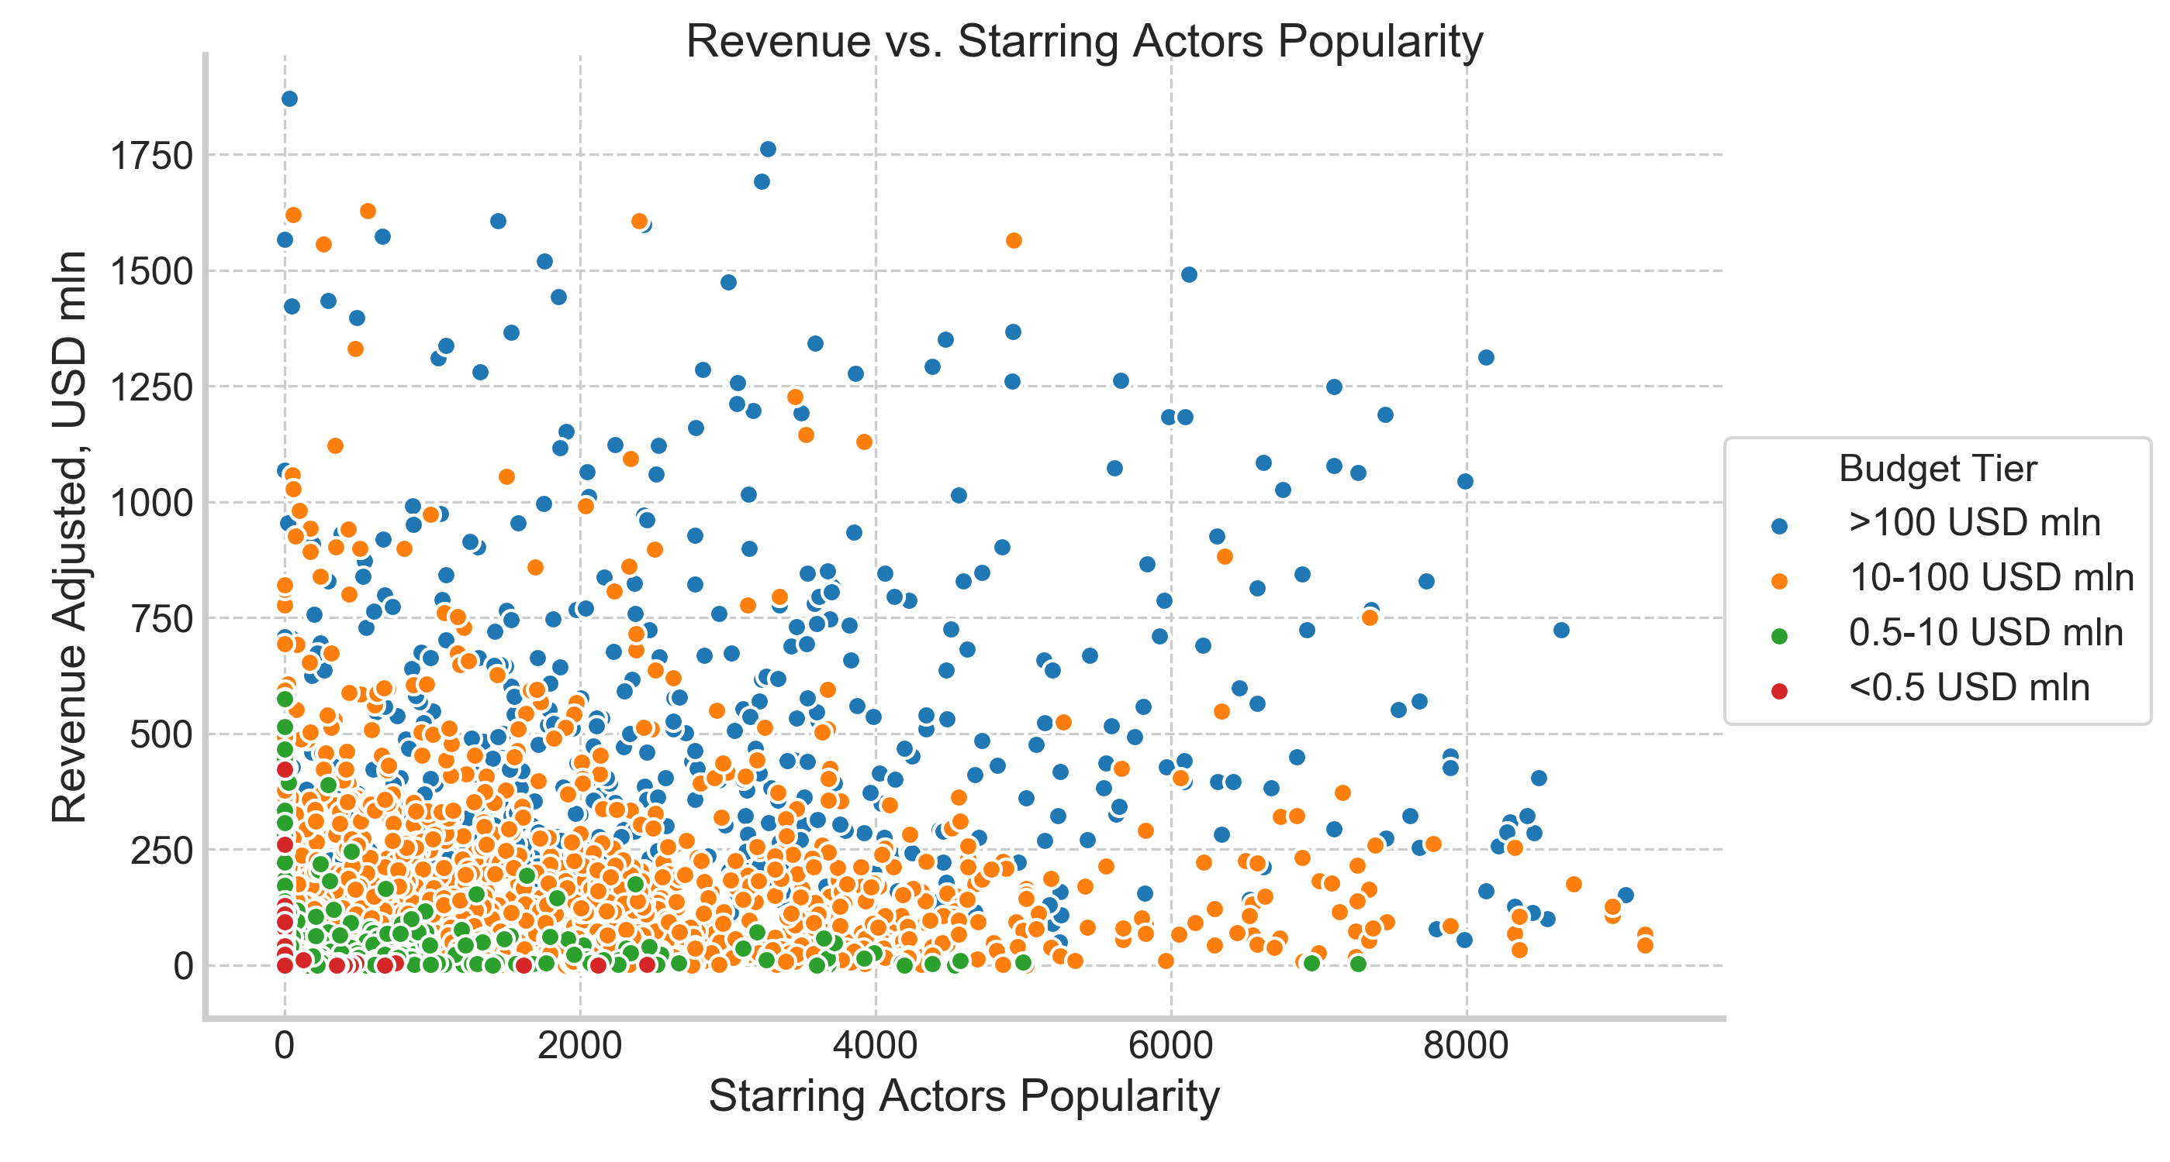
Visualizations
How do starring actors’ popularity impact box office revenues and avg viewer vote?

Slide 17
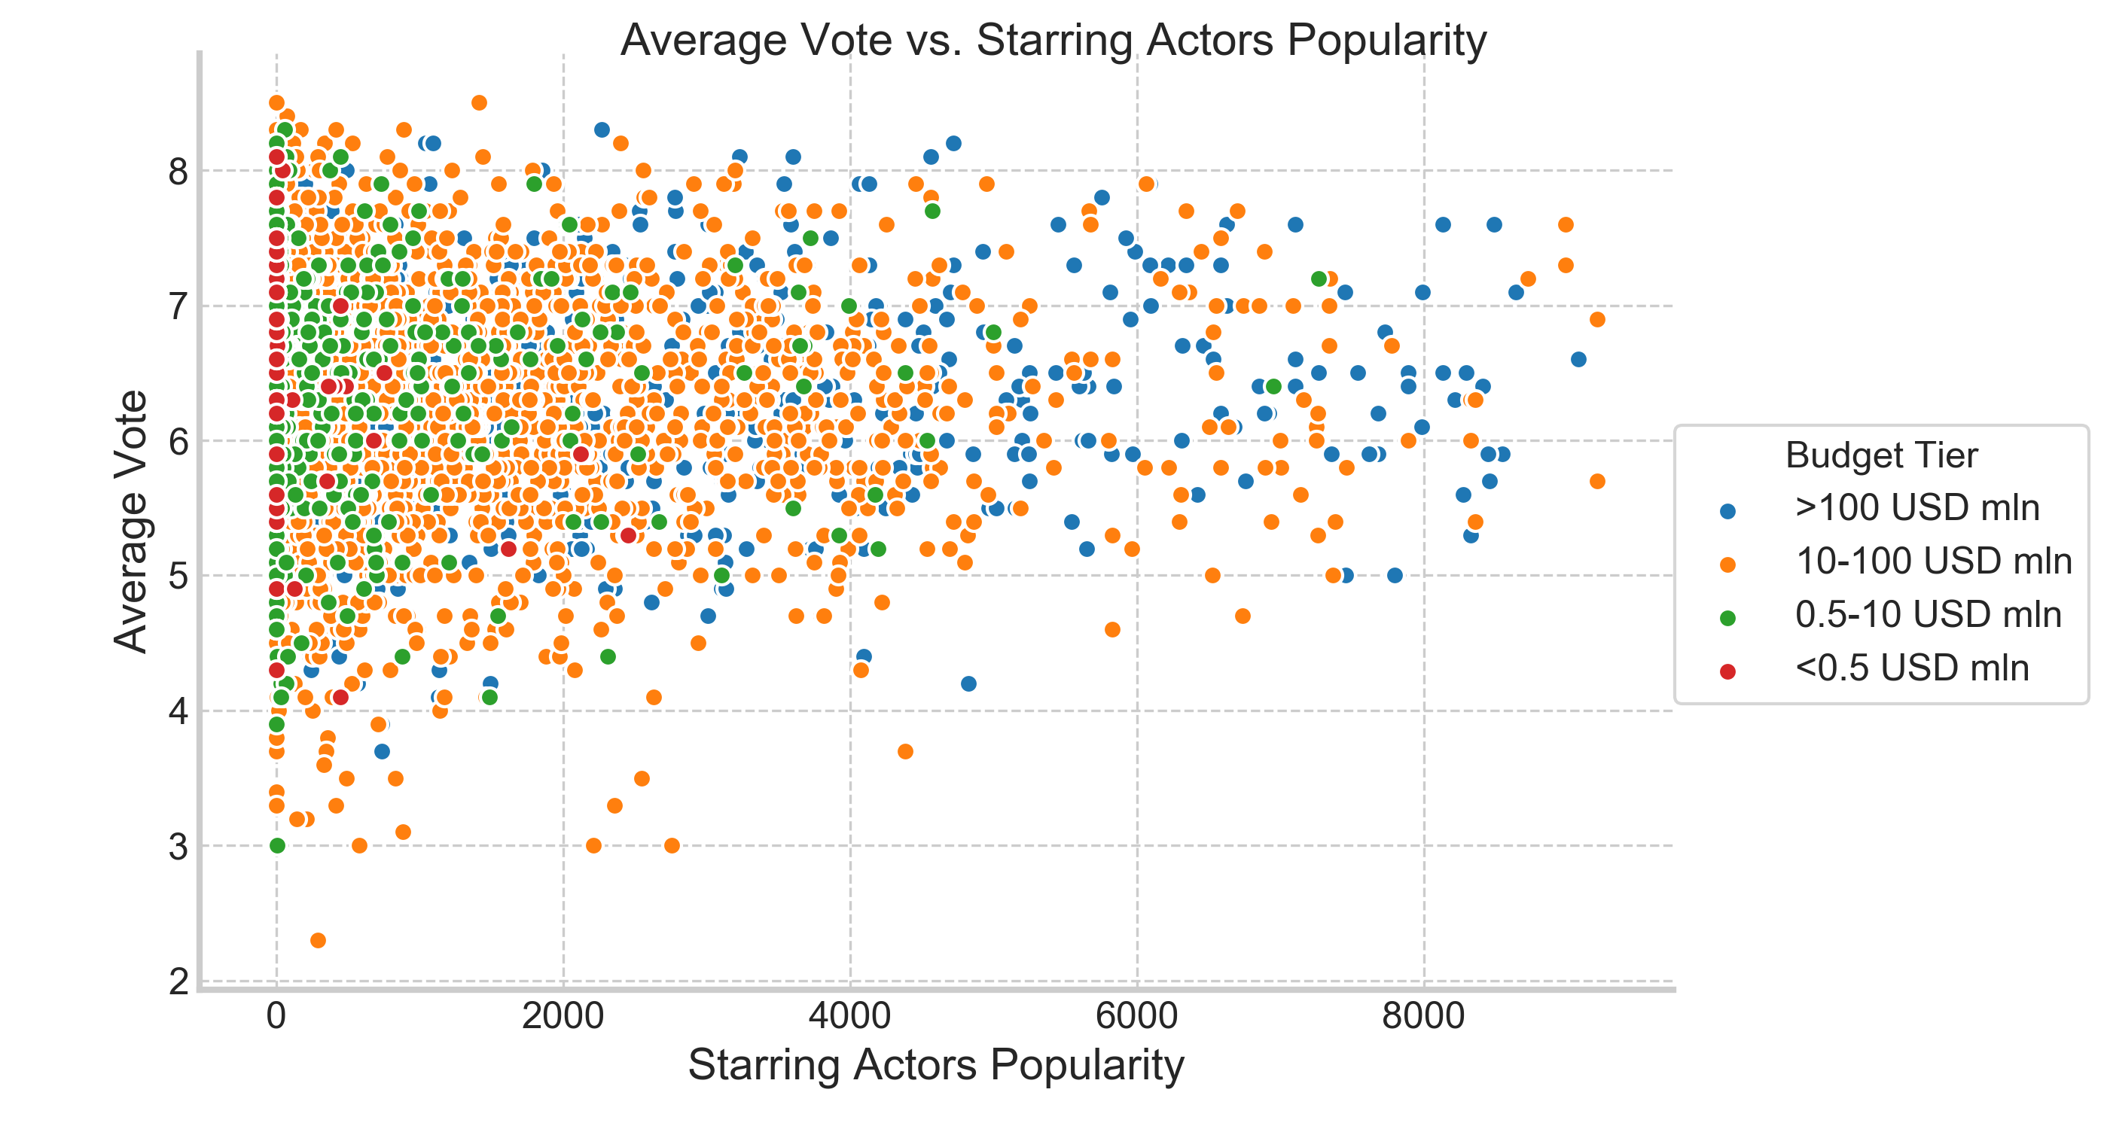
Visualizations
How do starring actors’ popularity impact box office revenues and avg viewer vote?

Slide 18
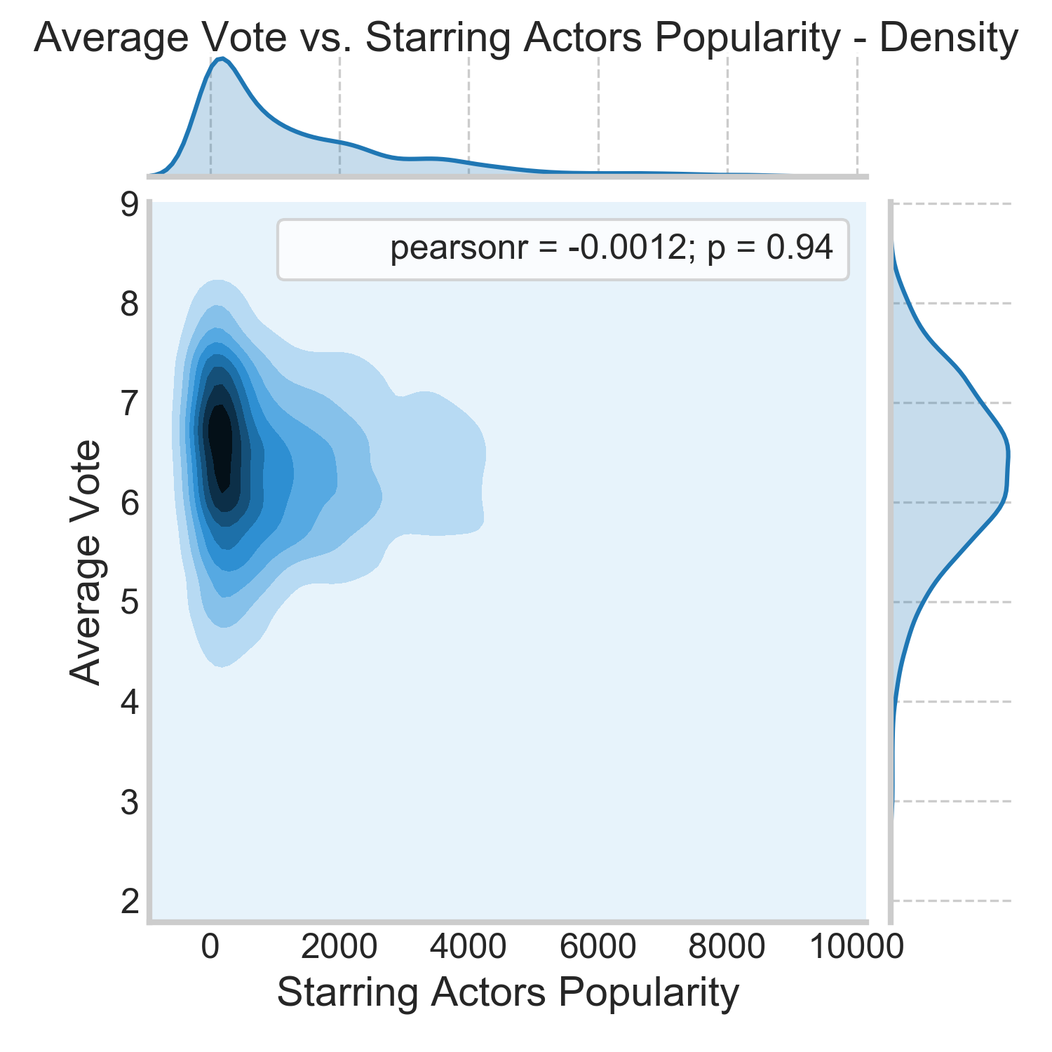
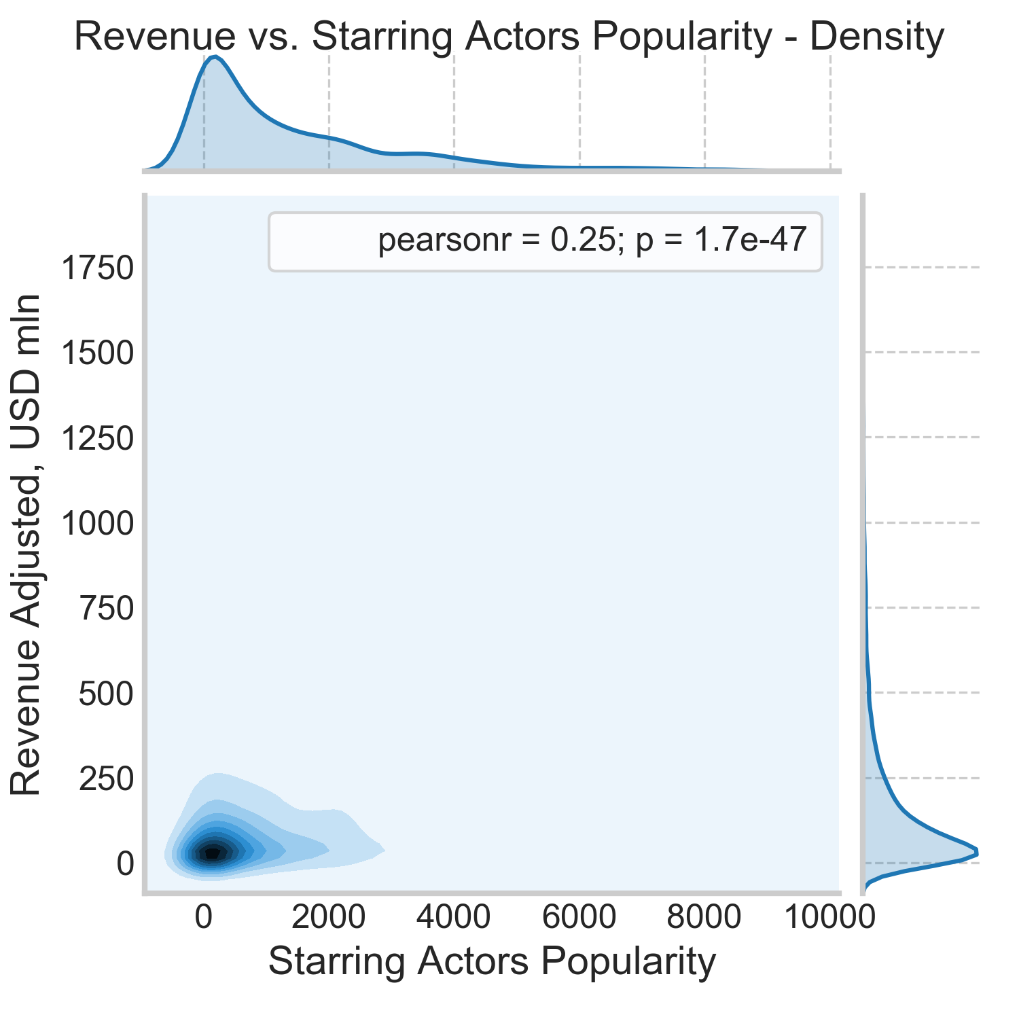
Major Findings
The popularity of starring actors, the way it was defined for this research, is not a determining factor for average vote and box office revenues.

Slide 19
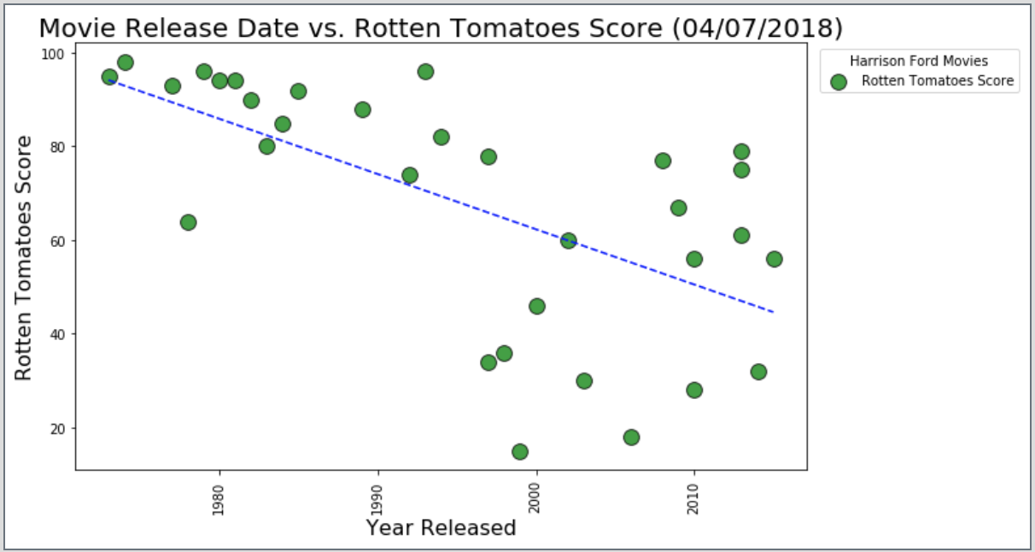
Visualizations
Certain actors have historically had great success right from their career onset. What does data result tell us about an actor’s career progression? Ex: using Harrison Ford movies over a period of time.

Slide 20
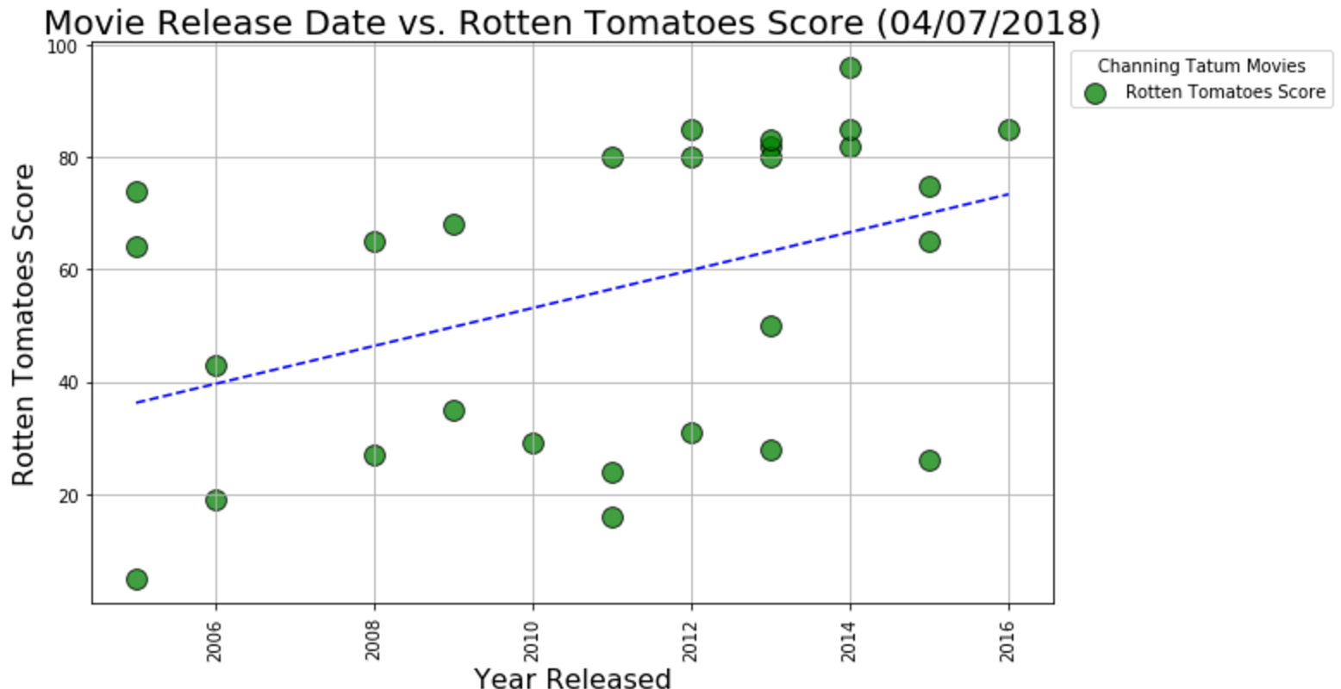
Visualizations
Certain actors have historically had great success right from their career onset. What does data result tell us about an actor’s career progression? Ex: using Channing Tatum movies over a period of time.

Slide 21
Major Findings
Using sample actor (Harrison Ford), his rotten tomato score showed a declining critic scores from approx. 1972 – 2017. Contrarily, Channing Tatum’s score showed an increase in critic scores from 2005 - 2017

Slide 22
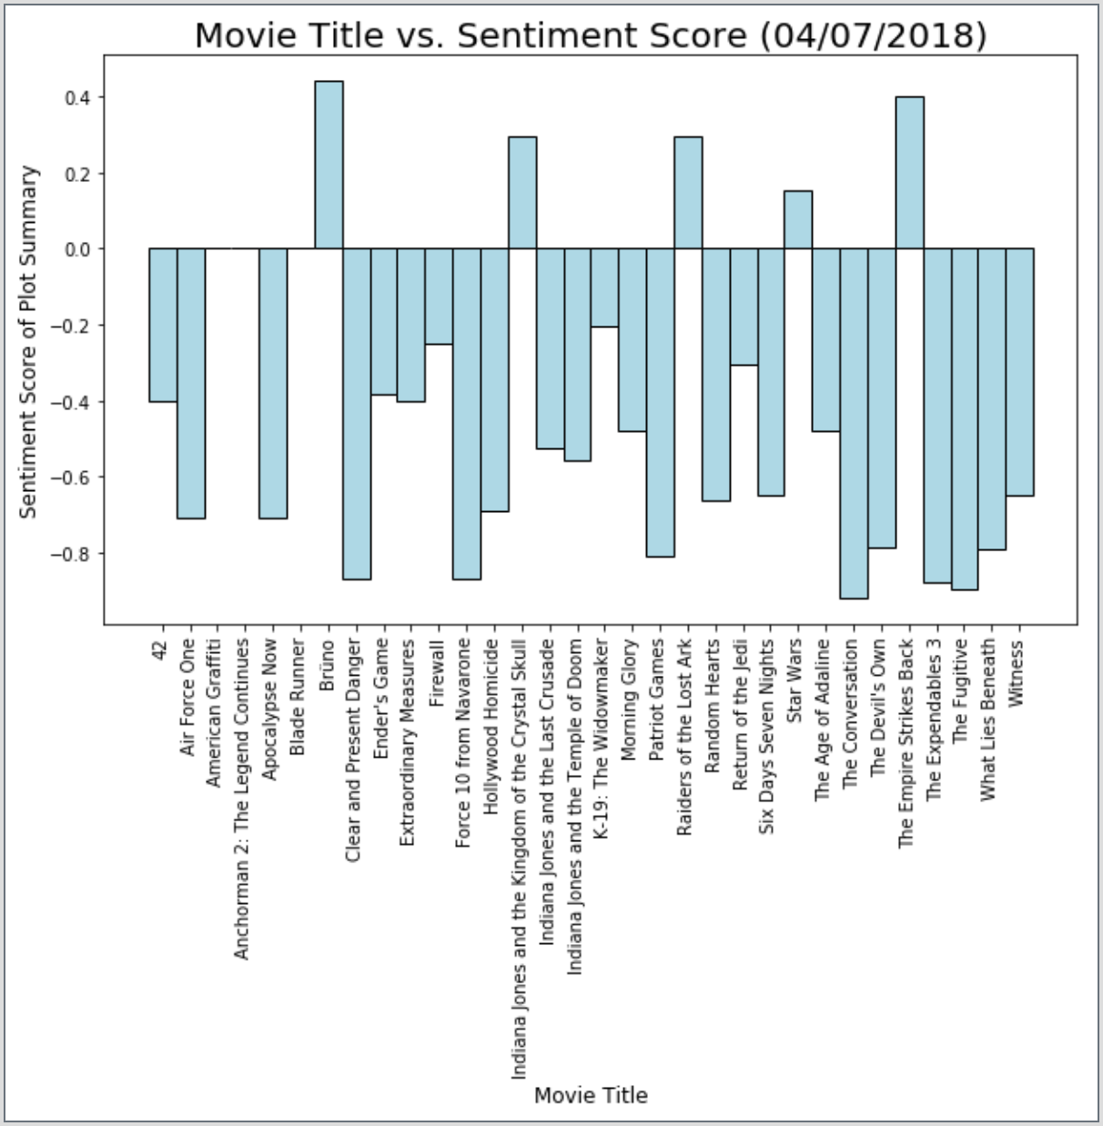
Visualizations
Do movie plots generally have a positive, negative or neutral sentiments attributed to them? Ex: using Harrison Ford movies.

Slide 23
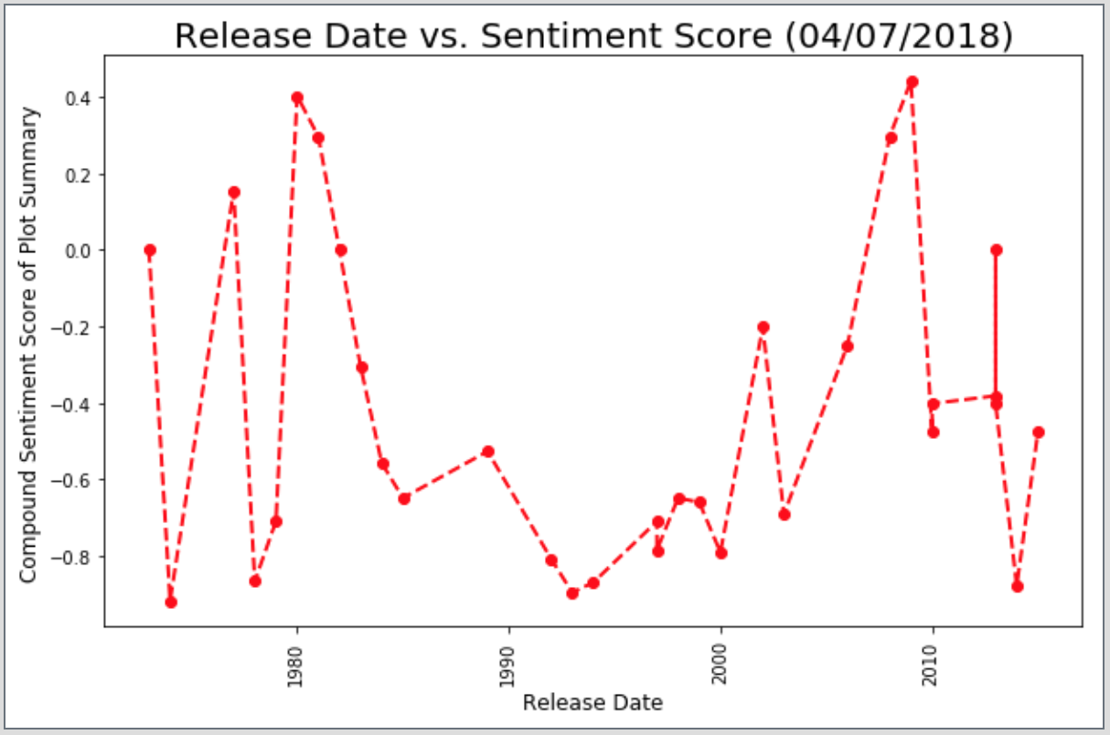
Visualizations
Do movie plots generally have a positive, negative or neutral sentiments attributed to them? Ex: using Harrison Ford movies over a period of time.

Slide 24
Major Findings
Using sample actor (Harrison Ford), his movie over the years have largely had a negative sentiments associated with the plots.

Slide 25
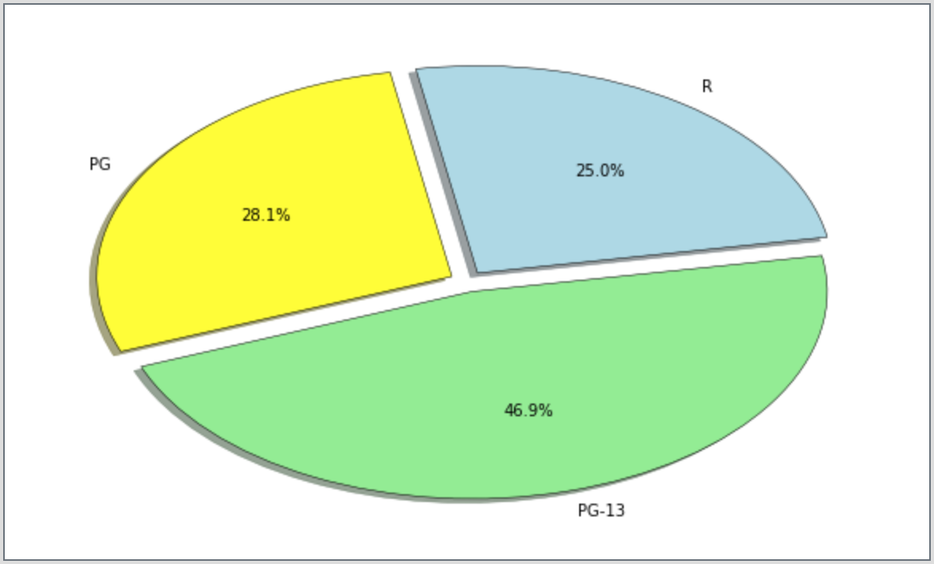
Visualizations
For specific actors, is there a trend for target audience? Using the graph of “% of Movies by Movie Rating”?

Slide 26
Major Findings
Close to 50% of movies released are rated PG-13, with additional 25% strictly restricted (rated R) – specifically for Harrison Ford.

